Slide 1
05 – Review of Inventory and Uncertainties
Geosense
Maximilian Fabi

Slide 2
Agenda What's happening today
1. Review of last week's inventory
2. Introduction to sampling uncertainty
3. Transition to the exercise in R
Results of our Inventory
Sampling uncertainty
Simulation of sampling a Forest

Slide 3
review
The data you recorded and handed in...

Slide 4

Objectives of the exercise
What do you guess?
https://img.welt.de/img/wissenschaft/mobile252720180/6597938837-ci23x11-w2000/GettyImages-1437280725.jpg

Slide 5
Objectives of the exercise
Getting to know the techniques and uncertainties
Influence of the correct selection of plots
Human factor
Measurement inaccuracy of the instruments used Influence of the weather ...
AND: Learning to submit data according to specifications is also included here! Sadly only one group managed to do that properly
https://img.welt.de/img/wissenschaft/mobile252720180/6597938837-ci23x11-w2000/GettyImages-1437280725.jpg

Slide 6
Results
What could we conclude from the collected data?
https://img.welt.de/img/wissenschaft/mobile252720180/6597938837-ci23x11-w2000/GettyImages-1437280725.jpg

Slide 7
Results
Basal area / volume
Basal area: Sum of the basal areas of all trees on a specific area (m2/ha)
Volume: Cubic meters per hectar (m3/ha)
Proportions of tree species, biomass, …
https://img.welt.de/img/wissenschaft/mobile252720180/6597938837-ci23x11-w2000/GettyImages-1437280725.jpg

Slide 8
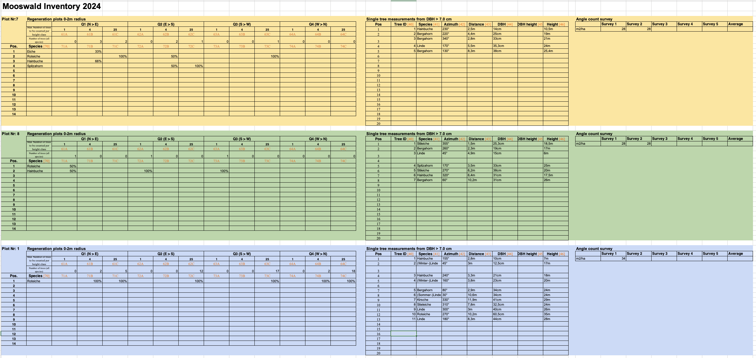
Results
What do we need for the basal area and the volume?
https://img.welt.de/img/wissenschaft/mobile252720180/6597938837-ci23x11-w2000/GettyImages-1437280725.jpg

Slide 9
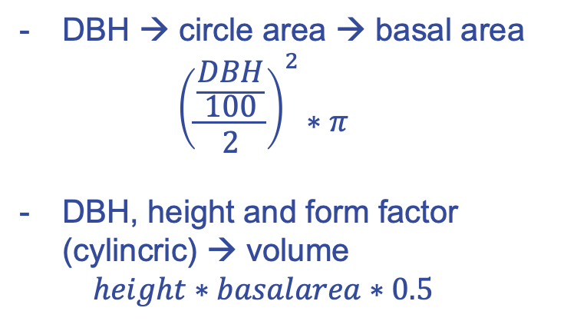
Results
DBH → circle area → basal area
$${\left(\frac{\frac{DBH}{100}}{2}\right)}^{2}∗π$$
DBH, height and form factor (cylincric) → volume
$$height∗basalarea∗0.5$$
https://img.welt.de/img/wissenschaft/mobile252720180/6597938837-ci23x11-w2000/GettyImages-1437280725.jpg

Slide 10
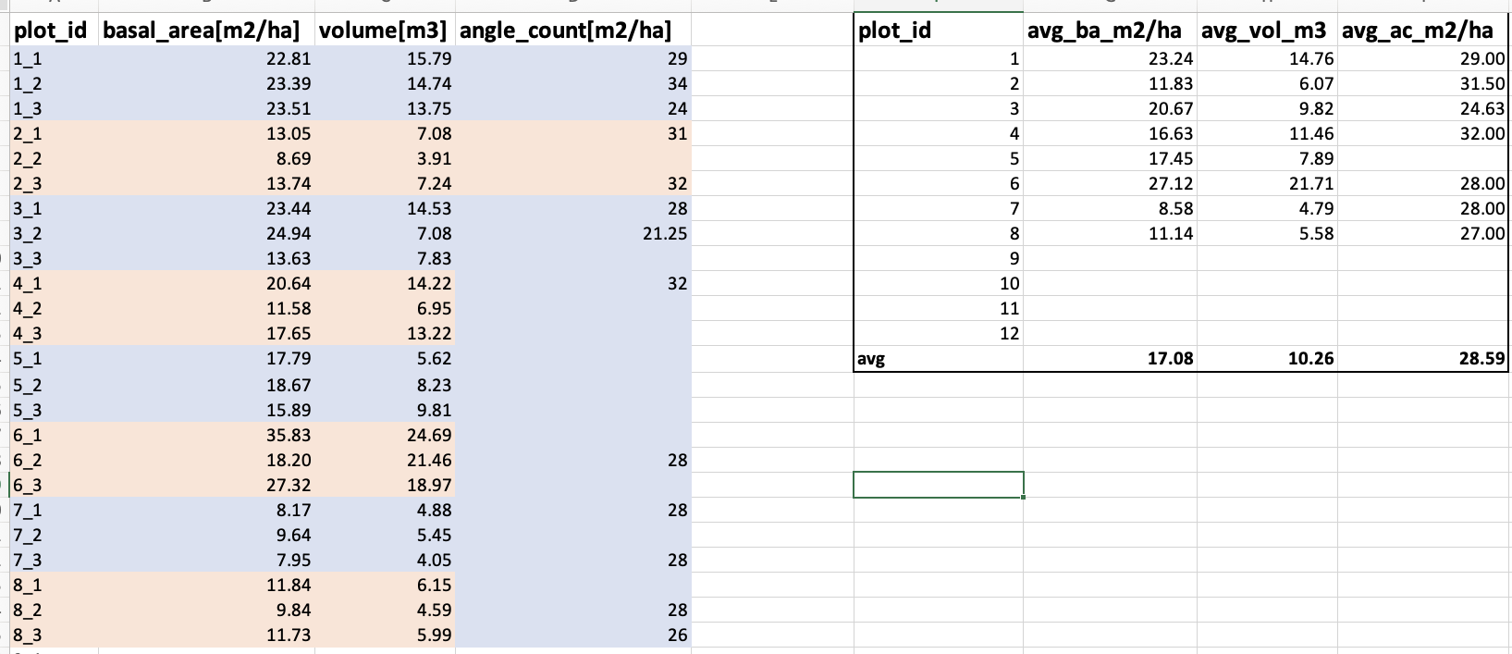
Results
Because tables are so beautiful and meaningful (note the irony), there are also graphics for this.
https://img.welt.de/img/wissenschaft/mobile252720180/6597938837-ci23x11-w2000/GettyImages-1437280725.jpg

Slide 11
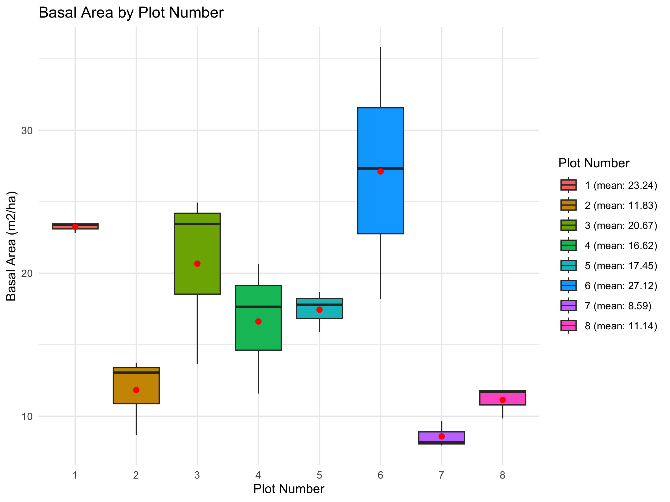
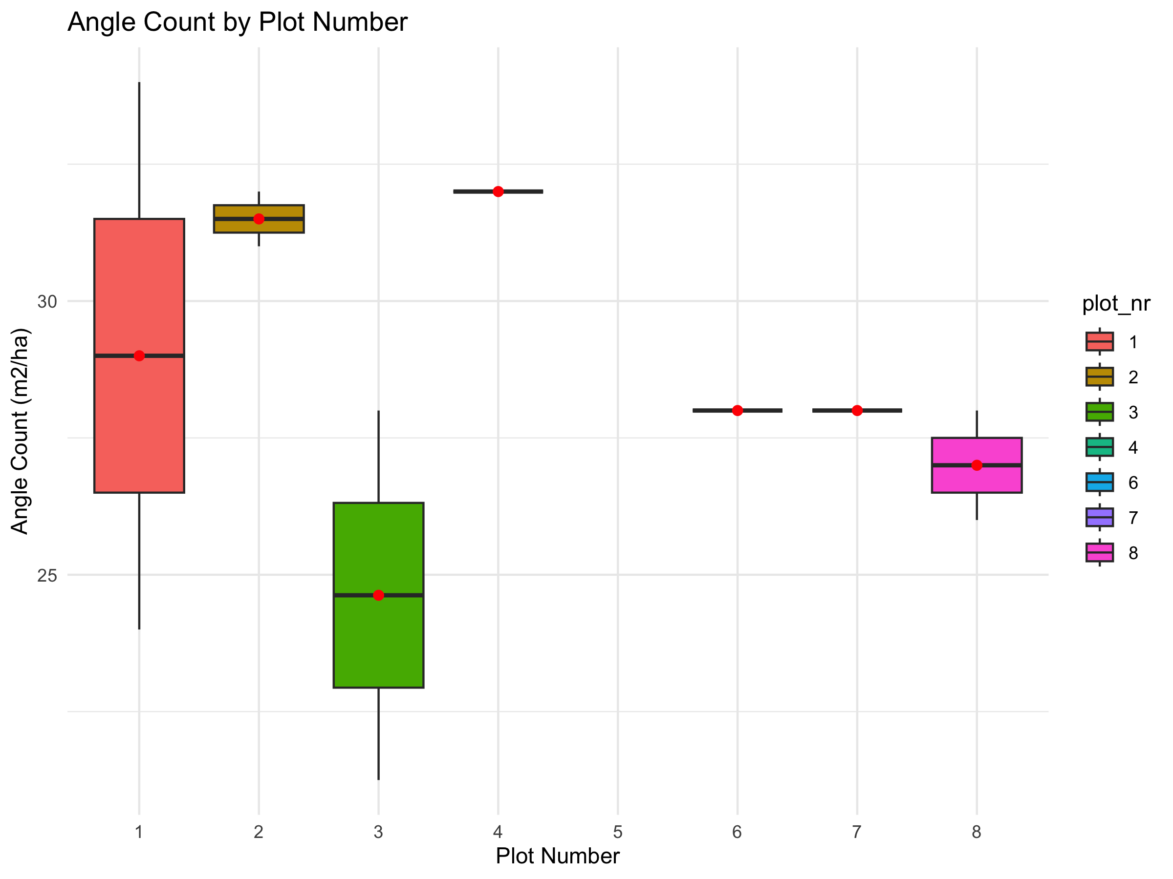
Results
Because of the lack of data from you, we use the data from another course
(we were hoping to merge the two datasets of you.. )

Slide 12
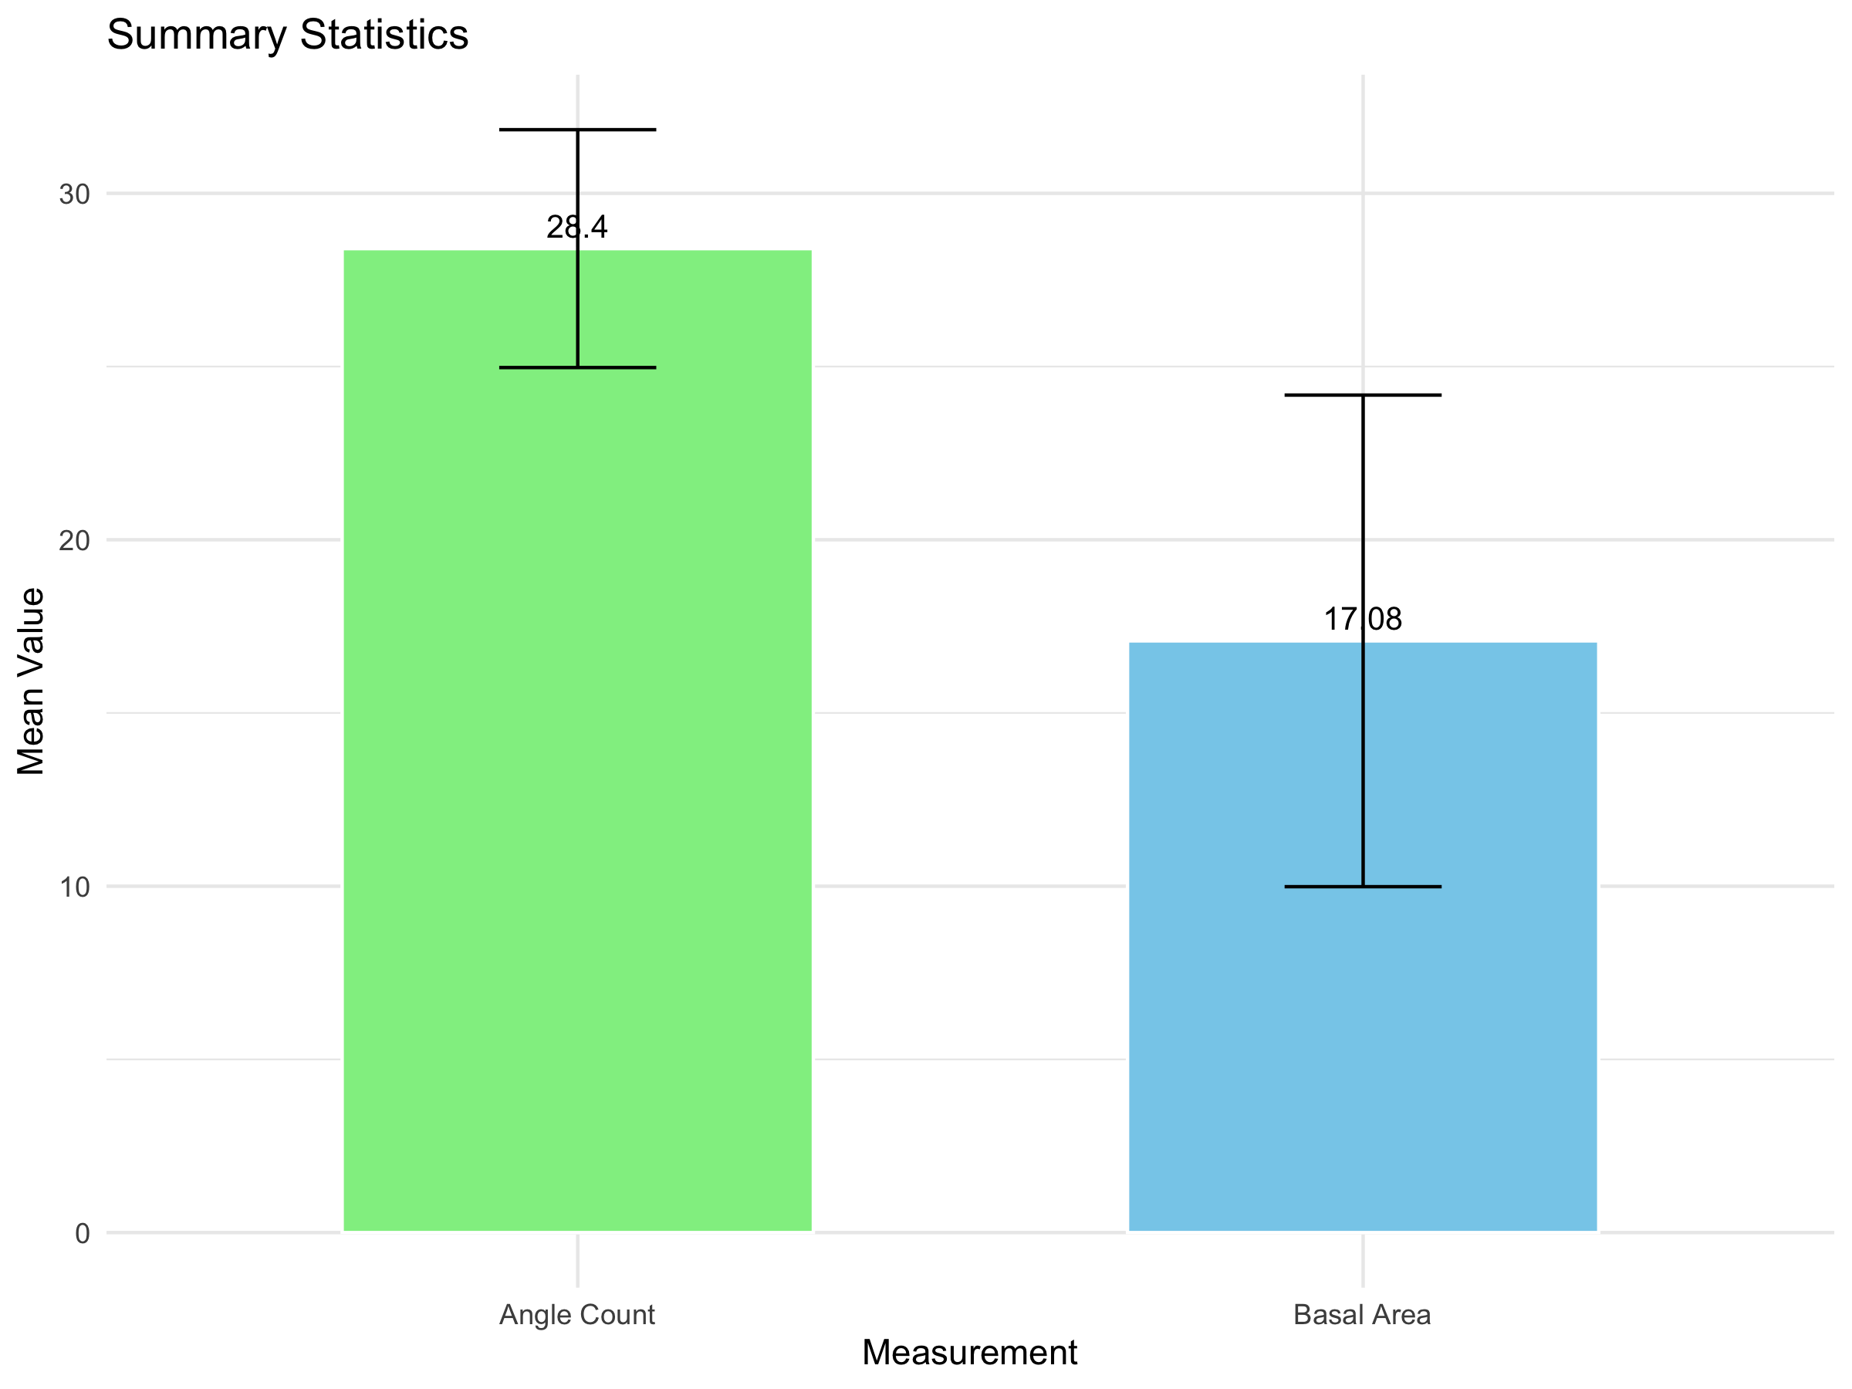
Results
Lots of data missing here, too

Slide 13
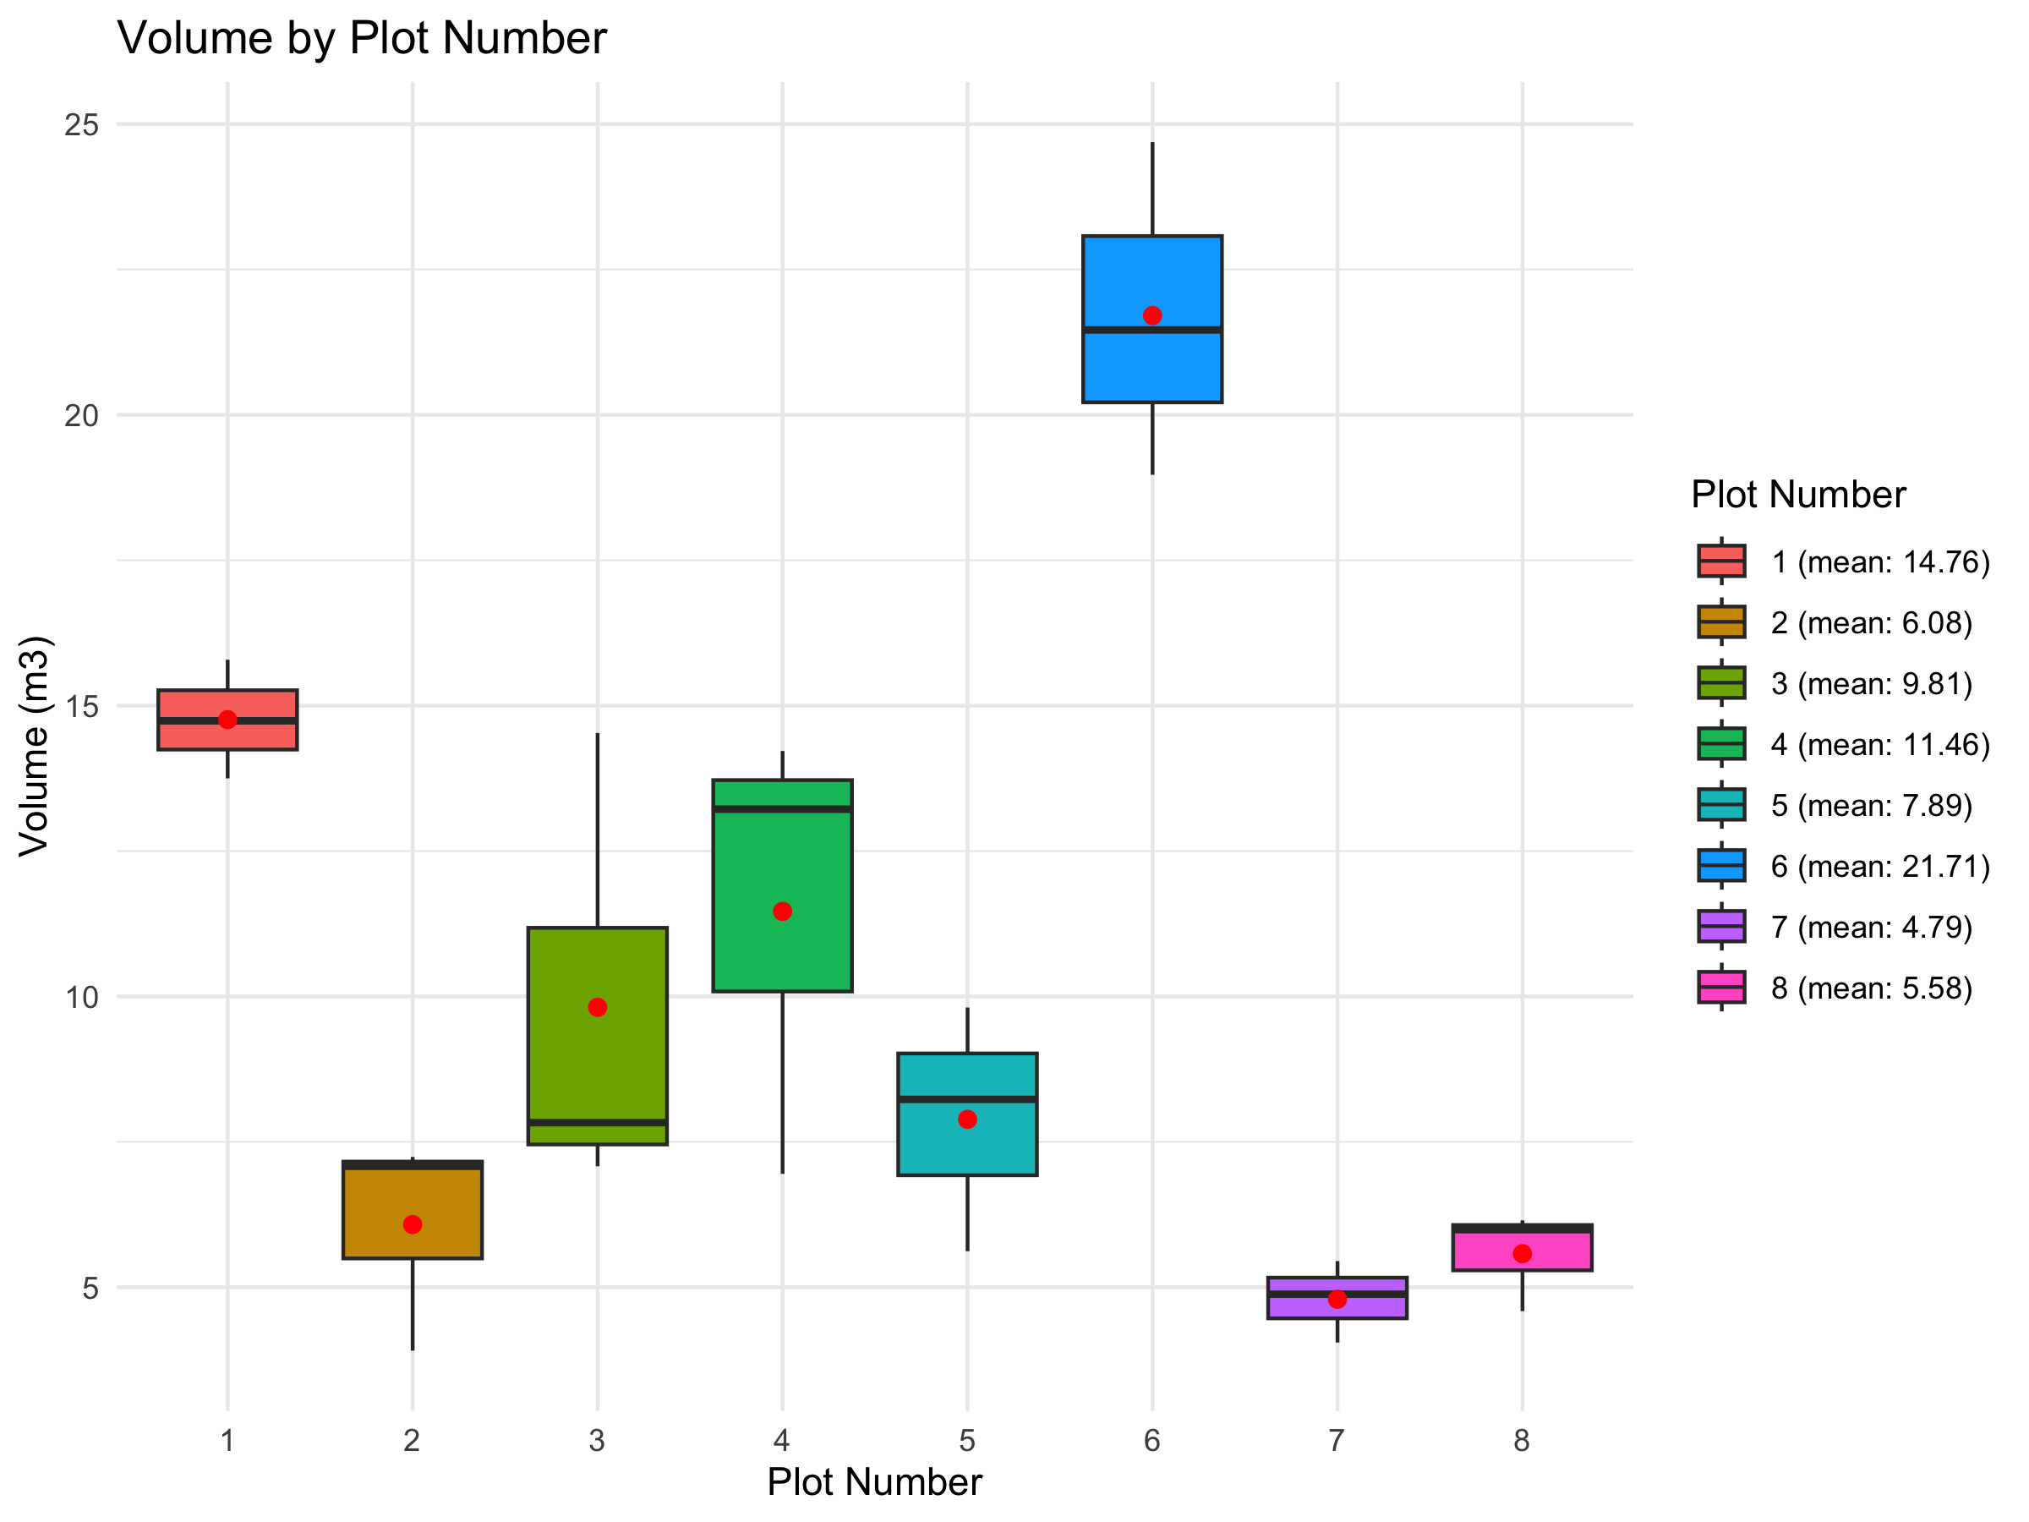
Results

Slide 14
Results
We could also look at the distribution of species, but the data was too inconsistent and many were missing.
We will continue to look at this in the exercise.

Slide 15
Results
Summary
The human factor plays a very significant role (who measures how accurately)
Plot selection has an extremely high influence
Different measuring instruments and techniques produce more accurate or less accurate results (angle count sampling)

Slide 16

Results
Summary
The human factor plays a very significant role (who measures how accurately)
Plot selection has an extremely high influence
Different measuring instruments and techniques produce more accurate or less accurate results (angle count sampling)
And it takes forever
https://www.google.com/url?sa=i&url=https%3A%2F%2Ftenor.com%2Fsearch%2Fspongebob-years-later-gifs&psig=AOvVaw1bIrcWPag6Y2eXiAIPscSp&ust=1731416038489000&source=images&cd=vfe&opi=89978449&ved=0CBQQjRxqFwoTCNj35sKp1IkDFQAAAAAdAAAAABAE

Slide 17
Introduction of sampling uncertainty
What do you generally have to pay attention to?

Slide 18
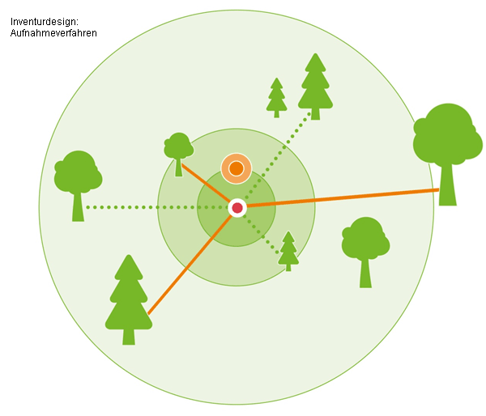
definition
Why don’t we record the entire tree population?
https://www.google.com/url?sa=i&url=https%3A%2F%2Fwww.waldwissen.net%2Fde%2Ftechnik-und-planung%2Fwaldinventur%2Feinfuehrung-in-die-bwi3&psig=AOvVaw3cej_rHtZPczaRHe_6ljko&ust=1731404386150000&source=images&cd=vfe&opi=89978449&ved=0CBQQjRxqFwoTCOjM7Iz-04kDFQAAAAAdAAAAABAE

Slide 19

definition
Why don’t we record the entire tree population?
It would simply be too time-consuming and expensive
https://www.google.com/url?sa=i&url=https%3A%2F%2Fwww.waldwissen.net%2Fde%2Ftechnik-und-planung%2Fwaldinventur%2Feinfuehrung-in-die-bwi3&psig=AOvVaw3cej_rHtZPczaRHe_6ljko&ust=1731404386150000&source=images&cd=vfe&opi=89978449&ved=0CBQQjRxqFwoTCOjM7Iz-04kDFQAAAAAdAAAAABAE

Slide 20
definition
Sampling uncertainty describes the uncertainties that result from using samples instead of full surveys. → what we did in the field!
Relevance for the forest inventory: complete recording is almost impossible or very time-consuming!
https://www.google.com/url?sa=i&url=https%3A%2F%2Fwww.waldwissen.net%2Fde%2Ftechnik-und-planung%2Fwaldinventur%2Feinfuehrung-in-die-bwi3&psig=AOvVaw3cej_rHtZPczaRHe_6ljko&ust=1731404386150000&source=images&cd=vfe&opi=89978449&ved=0CBQQjRxqFwoTCOjM7Iz-04kDFQAAAAAdAAAAABAE

Slide 21
uncertainties
Random errors: Unavoidable deviations, natural variability within the forest stand. Even if a random sample is taken, the selected area can differ greatly in its properties from the average of the entire stand, leading to inaccuracies.
Systematic errors: Errors resulting from inadequate or distorted selection methods. Fixed, recurring influence. E.g. due to faulty instruments, incorrect methods or subjective influences
Random errors
Systematic errors

Slide 22
uncertainties
Random errors: Unavoidable deviations
natural variability within the forest stand. Even if a random sample is taken, the selected area can differ greatly in its properties from the average of the entire stand, which leads to inaccuracies.
Systematic errors: Errors resulting from inadequate or distorted selection methods.
Fixed, recurring influence. E.g. due to faulty instruments, incorrect methods or subjective influences
→ Variability in the forest: Trees and locations differ greatly, which can lead to samples not being fully representative. Additional factors such as altitude, soil quality and rainfall influence growth and thus also the results of the samples.

Slide 23
quantification of uncertainty
Confidence intervals: Range within which the true mean of the entire population lies with a certain probability (e.g. 95%).
→ Larger samples lead to narrower confidence intervals and thus to greater precision – but more work required.
Standard error (SE): Measure of the accuracy of the estimate of the mean.
Variance and dispersion: By calculating the variance of the data collected, the uncertainty in the estimated values ​​can be quantified.

Slide 24
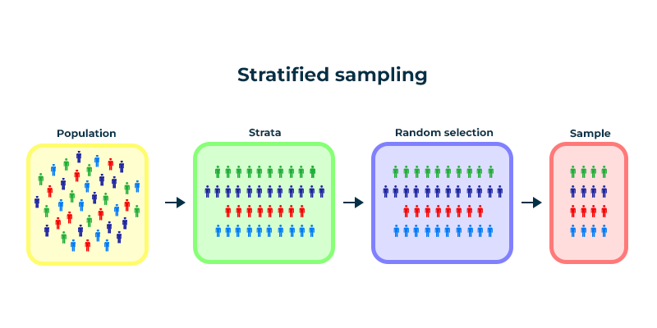
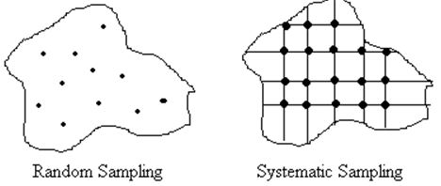
reducing uncertainty
In general: Increase sample size - More measurement points improve accuracy and reduce uncertainty.
1) Stratified sampling: The forest is divided into homogeneous layers (e.g. by tree species or age) and separate samples are taken for each layer. This increases precision because differences between layers are taken into account.
2) Systematic sampling: Instead of randomly, samples are taken at fixed intervals, e.g. every 100 meters along a grid. This method can ensure better coverage and more even distribution.
https://www.google.com/url?sa=i&url=https%3A%2F%2Fwww.geeksforgeeks.org%2Fstratified-random-sampling-an-overview%2F&psig=AOvVaw0-THJ857kquPKlAo4HLk5t&ust=1731586841705000&source=images&cd=vfe&opi=89978449&ved=0CBQQjRxqFwoTCJjrreal2YkDFQAAAAAdAAAAABA4
https://www.google.com/url?sa=i&url=https%3A%2F%2Fforestrypedia.com%2Fthe-forest-resource%2F&psig=AOvVaw2iWvngqhGBn08rVFWvlw_w&ust=1731586906681000&source=images&cd=vfe&opi=89978449&ved=0CBQQjRxqFwoTCMCLpYmm2YkDFQAAAAAdAAAAABAE

Slide 25
reducing uncertainty
More precise
More work needed
In general: Increase sample size - More measurement points improve accuracy and reduce uncertainty.
1) Stratified sampling: The forest is divided into homogeneous layers (e.g. by tree species or age) and separate samples are taken for each layer. This increases precision because differences between layers are taken into account.
2) Systematic sampling: Instead of randomly, samples are taken at fixed intervals, e.g. every 100 meters along a grid. This method can ensure better coverage and more even distribution.
More precise
Need to know the forest stand
More precise
A lot of plots required

Slide 26
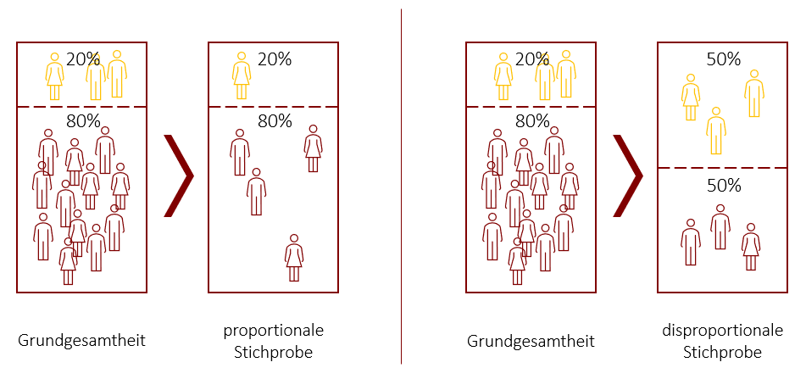
reducing uncertainty
1) Example forest:
Stock 80% beech, 20% spruce
→ If I were to represent 50% spruce in my sample, I would have a distorted image of the entire forest stock.
Whole data
Proportional sample
Whole data
disproportional sample

Slide 27
reducing uncertainty
2) Example forest:
Stock 80% beech, 20% spruce
Regular grid ensures that the samples are evenly distributed and more closely meshed.
But a lot of work.
https://www.google.com/url?sa=i&url=https%3A%2F%2Fforestrypedia.com%2Fthe-forest-resource%2F&psig=AOvVaw2FP_b4u0MEqYcHdj4zTbZ_&ust=1731406440693000&source=images&cd=vfe&opi=89978449&ved=0CBQQjRxqFwoTCLCehuGF1IkDFQAAAAAdAAAAABAI

Slide 28
Summary
We now know
... what sampling uncertainty is
... why it is important for forest inventories
... that there are random and systematic errors
... how we can quantify these errors
... how we can address the uncertainties

Slide 29
Summary
We don't yet know
... how large these uncertainties are in a large, real forest stand
→ Exercise in R

Slide 30
Questions?
What questions do you have so far?

Slide 31
Transition to the exercise in R
We will now simulate one or more samples.

Slide 32
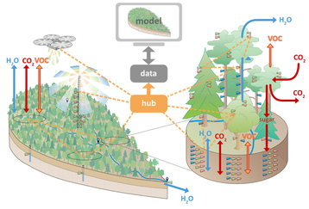
Full inventory of Ecosense https://ecosense.uni-freiburg.de/
Research site near Ettenheim with measuring instruments
Climate change threatens forests worldwide and impairs their function as carbon sinks.
Central European forests are increasingly suffering from heat waves, floods and droughts.
But: Important knowledge about forest processes and their future changes is lacking.
→ ECOSENSE researches critical ecosystem changes and develops an intelligent sensor network.
→ The aim is a rapid, cost-effective assessment of ecosystems in extreme forest areas.

Slide 33
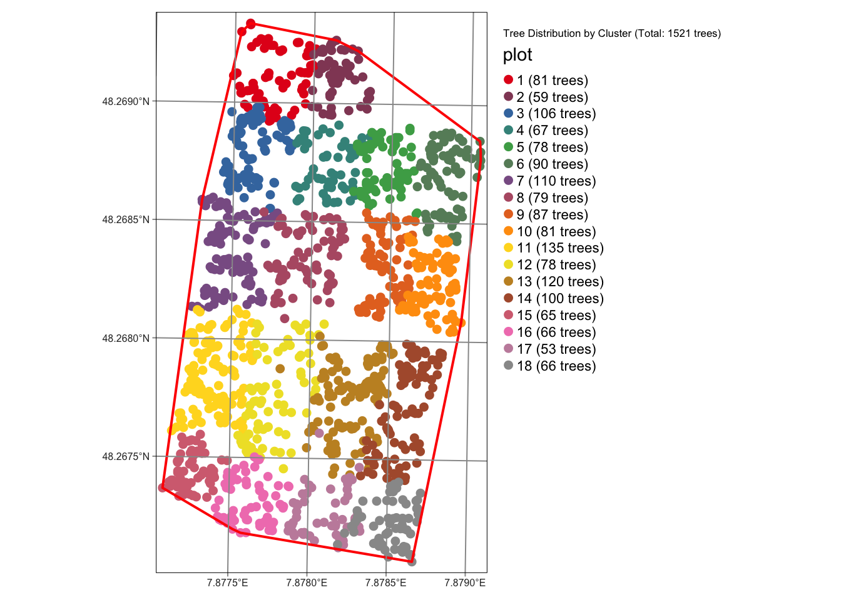
Full inventory of Ecosense https://ecosense.uni-freiburg.de/
Download the file ex05-pw.zip and unpack the data where you can find it again.
Password is: Inventory
Open the .qmd file in Rstudio
The geopackage contains tree coordinates, as well as many other attributes of 1521 trees

Slide 34
What exactly are we doing today
Basic statistics
Simulate sampling
random sampling and regular grid
“real scenario”
Influence of GNSS uncertainty to Plot measurements

Slide 35
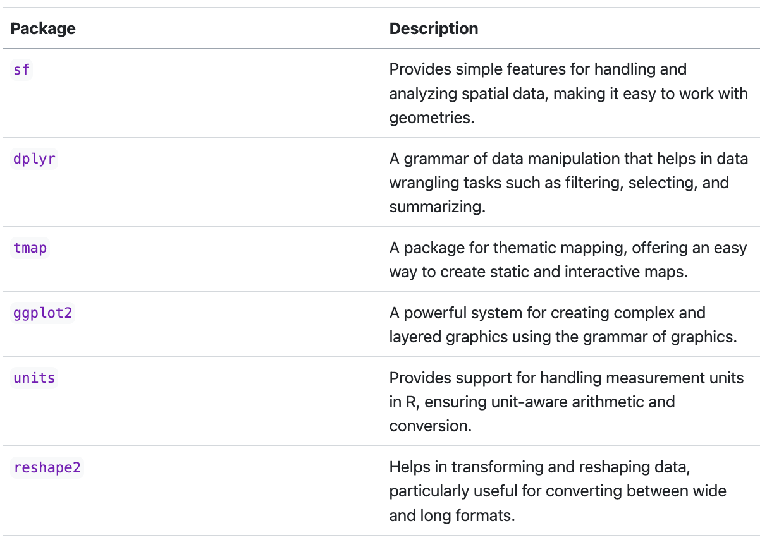
Small refresher of the required packages in R
Working with geodata →
General feature handling
- buffer, clip etc.
Working with geodata →
Nice tool for creating maps

Slide 36
Packages in R
[Internal advertising] If you are more interested in this → Course from geography to geodata with R:
https://thinking-spatial.org/courses/angewandte_geodatenverarbeitung/

Slide 37
dplyr
tree data
gruppieren
summe
# Calculate number of trees per cluster/plot
trees_per_plot <- tree_inventory_data %>%
group_by(plot) %>%
summarize(tree_count = n())
This section of code uses the %>% operator
The operator enables what is known as pipelining, a concept in which the output of one function is passed directly as input to the next function.

Slide 38
sf package
# Read a specific layer from the GeoPackage
tree_inventory_data <- st_read("tree_inv_ike.gpkg", layer = "datasheet_ecosense2023")
The sf package in R is used for working with spatial (geographical) data.
Geodata analysis
based on the Simple Features Standard

Slide 39
sf package
1. Import and export data
st_read() and st_write(): Imports/exports spatial data in various formats, e.g. shapefiles, GeoJSON, KML.
2. Create and manipulate geometries
st_point(), st_linestring(), st_polygon(): Creates points, lines and polygons.
st_geometry(): Extracts or sets the geometry column in an sf object.
st_union(), st_intersection(), st_difference(): Performs geometry operations such as union, intersection or difference.
3. Spatial calculations
st_area(), st_length(), st_distance(): Calculates area, length and distance of geometric objects.
st_centroid(): Calculates the center of polygons.
4. Transformations and projections
st_transform(): Changes the projection of a spatial object (e.g. from geographic coordinates to a Cartesian projection).
st_crs(): Sets or returns the coordinate system.
5. Processing and analyzing data
st_join(): Combines two sf objects based on spatial relationships (e.g. within, overlapping).
st_buffer(): Creates a buffer around geometries.

Slide 40
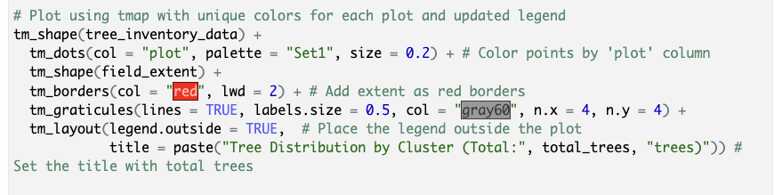
tmap package
tm_shape(): Sets the data basis for the map (e.g. point or area data), which is then visualized in further steps.
+ tm_dots(): Draws points for each tree position and colors them according to the "plot" value, so that each group gets a different color.
+ tm_borders(): Adds a border line around the shape data (e.g. the study area), here red and slightly thicker.
+ tm_graticules(): Adds a grid to the map, which creates orientation and reference points in the background.
+ tm_layout(): Adjusts the layout, e.g. placing the legend outside the map and setting a title with the total number of trees.

Slide 41
ggplot2 package
ggplot2 is a powerful and flexible R package for data visualization based on the concept of the so-called Grammar of Graphics.
→ Modularly customizable (similar to tmap)
Basic structure:
ggplot(data = <data>) +
aes(x = <X-axis variable>, y = <Y-axis variable>) +
geom_<type>() +
theme() +
labs()
Points, polygons, boxplot, etc.
fonts etc.
Labels/Text

Slide 42
Switch to Rstudio (if you want)
Now we will look at the exercise in Rstudio
Basic structure of the document:
- Loading and viewing data, using sf and tmap packages
- Statistics about the forest cover (basal area, species, DBH)
- Plot selection and uncertainties
- Simulation
- Questions to answer (woohoo)

Slide 43
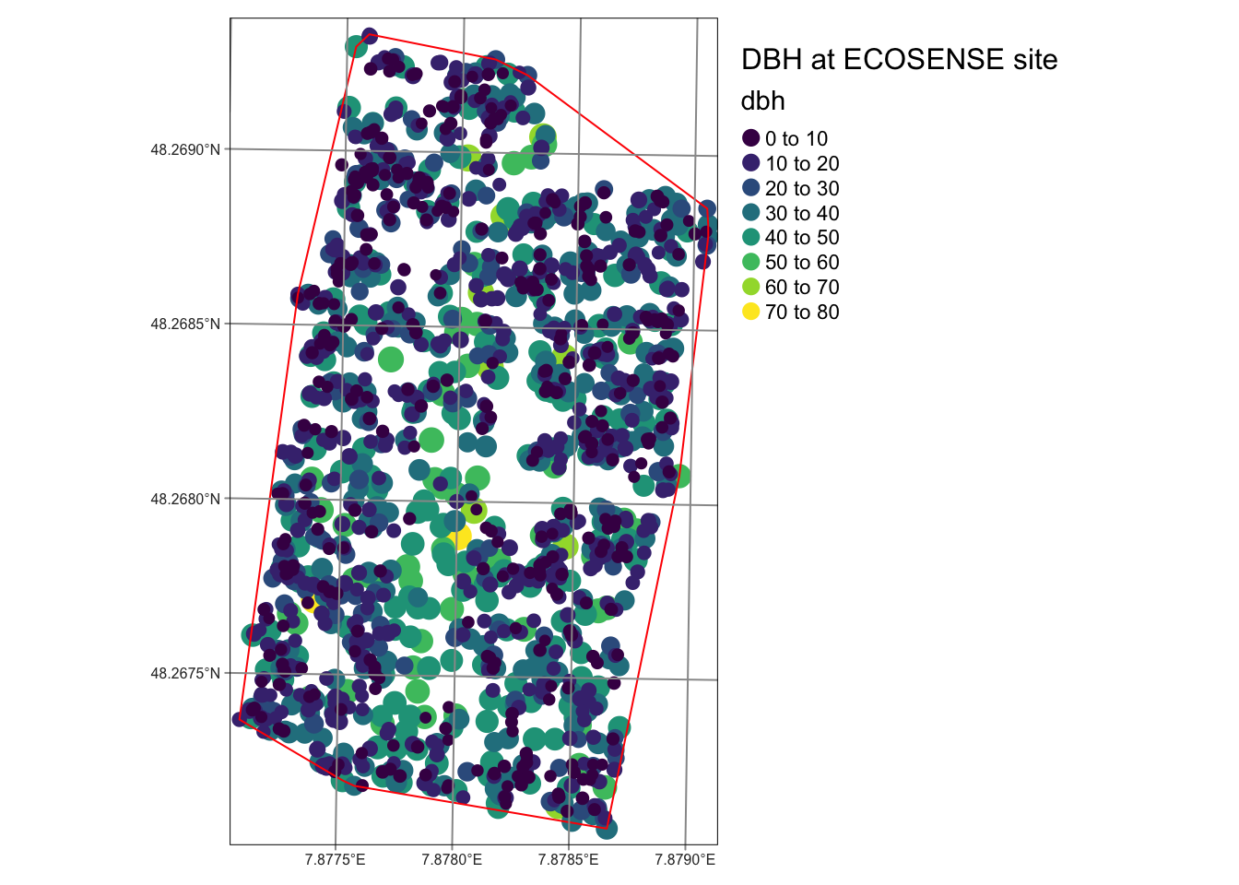
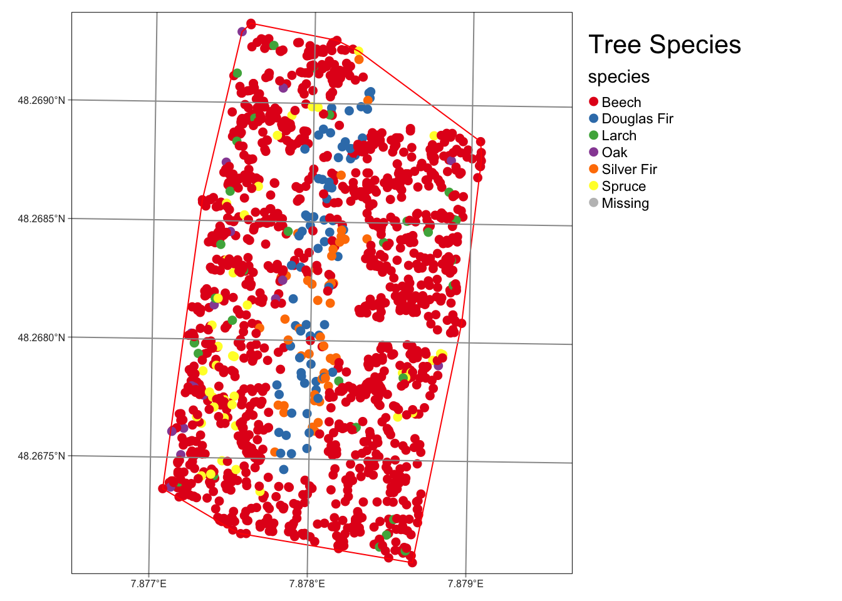
Viewing data in R
What do we see?

Slide 44
Viewing data in R
Right Small trees outside, large trees in the middle
Many beeches, many Douglas firs

Slide 45
Viewing data in R
Think back to the exercise – which option would (probably) be the more meaningful:
1
2

Slide 46
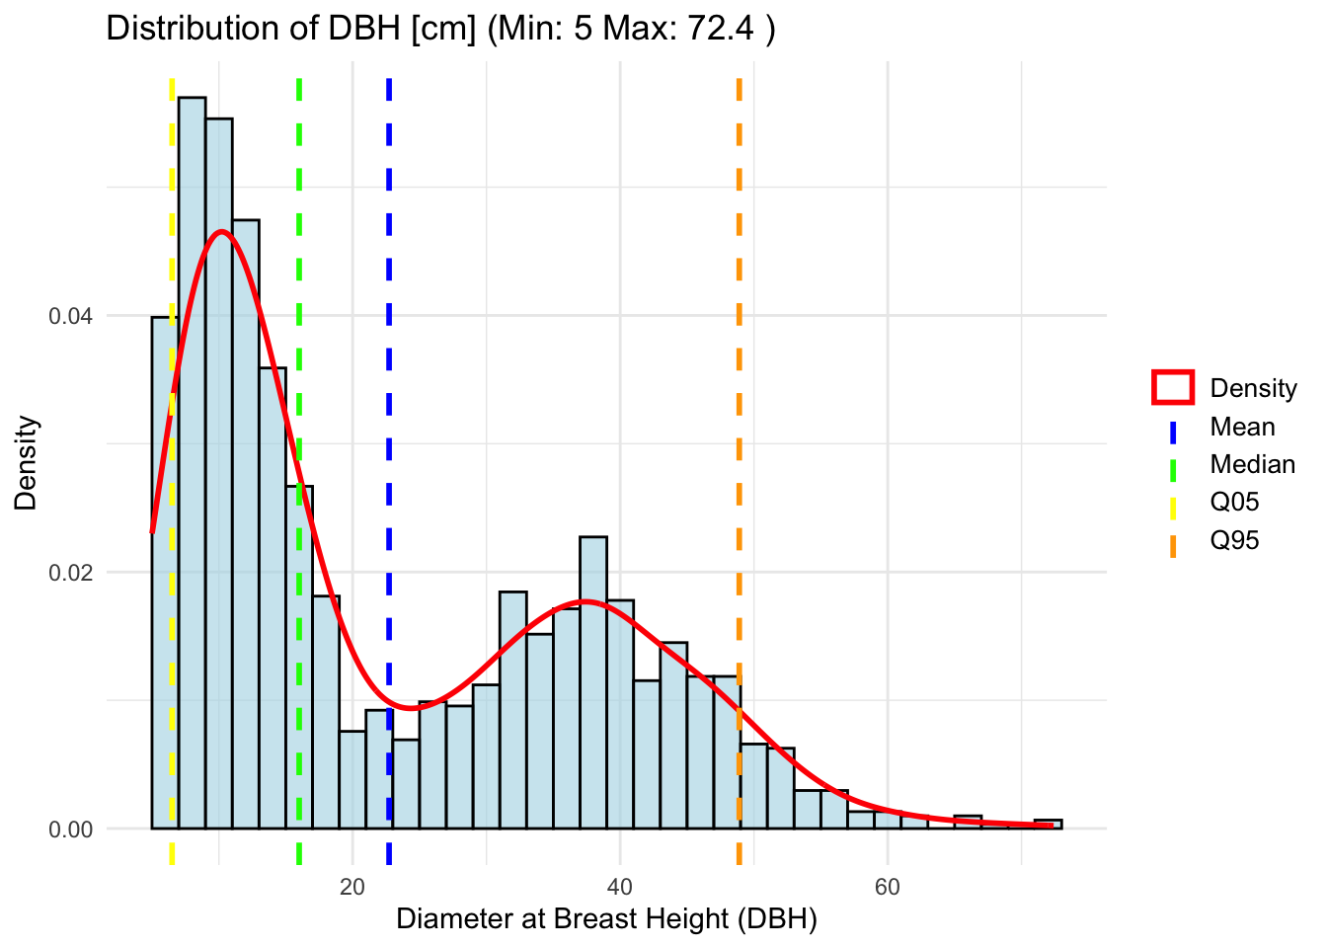
Viewing data in R
What does this graphic tell us?
Small trees? Big trees? Well distributed? Young or old forest?

Slide 47
Viewing data in R
Bimodal distribution of trees
Hence high deviations from the average
Base area calculated from this: 31.68 m2/ha

Slide 48
Viewing data in R
Distribution and significance of DBH (cm):
Mean (22.72) vs Median (16): Median lower than the mean, indicating right-skewed distribution.
Mode (9): Most frequent value, lower than mean and median, also supports right-skewed distribution.
Standard deviation (14.89): Measure of dispersion around the mean; high value indicates variability.
IQR (25.9): Range of the middle 50% of the data; large value compared to the median indicates wide range of values.
Summary: The distribution is right-skewed (mean > median > mode) with high variability (high standard deviation and IQR).
→ A few very large values/trees

Slide 49
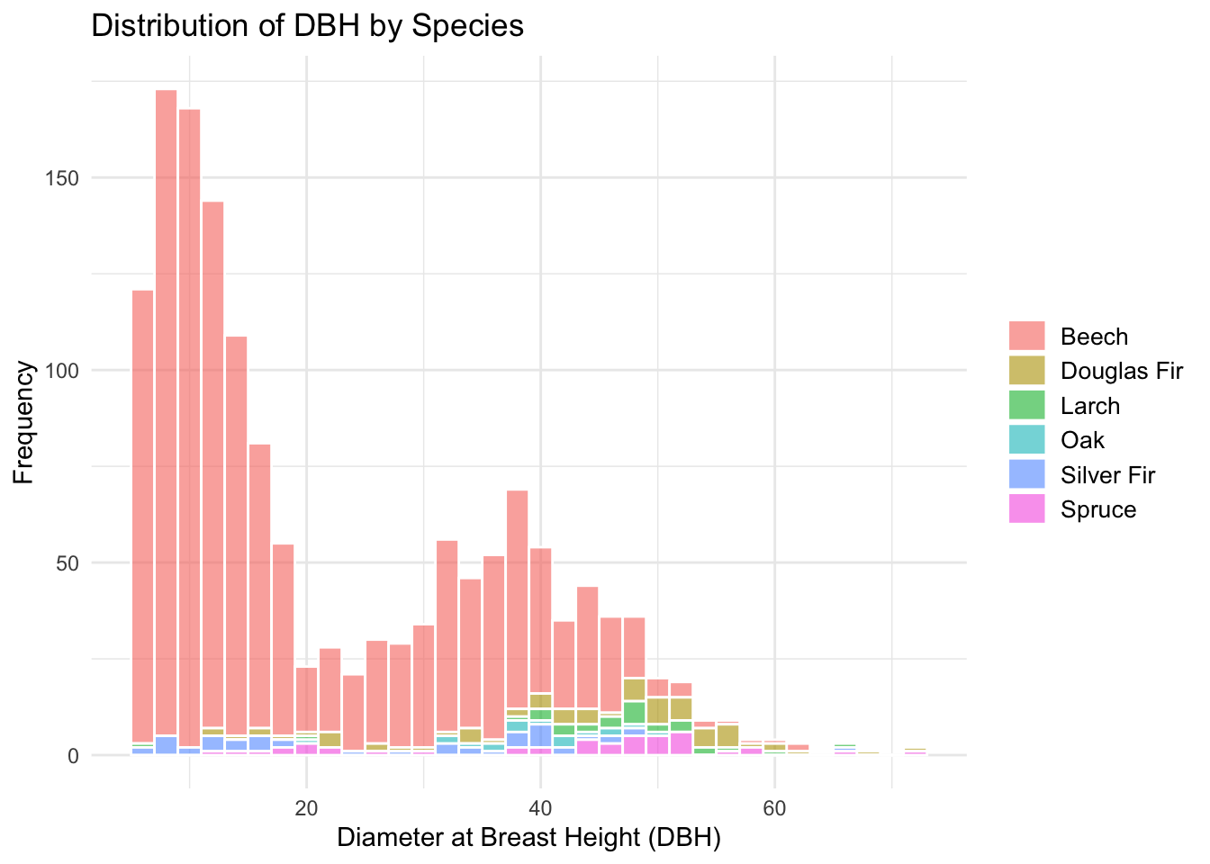
Viewing data in R
Species distribution
What does this graph show us?
What do you notice?

Slide 50
Viewing data in R
Species distribution
Colors are relative to the entire stand
Many young beeches
Some larger oaks, Douglas firs and larches
…

Slide 51
Rest in the exercise in the afternoon
We will simulate one or more samples.

Slide 52
Viewing data in R Simulation of samples – Random sampling and regular grid
Simulation
Random points
Regular grid
We do 2 simulations and see what happens:
1. Random plots
2. Regular grid
In the example, we take a sample of 10 randomly distributed points (plots) in the existing area 100 times
From this we can derive the basal area each time and see how well (or badly) we did
We do this for the 2 options of plot distribution mentioned and look at the results!

Slide 53
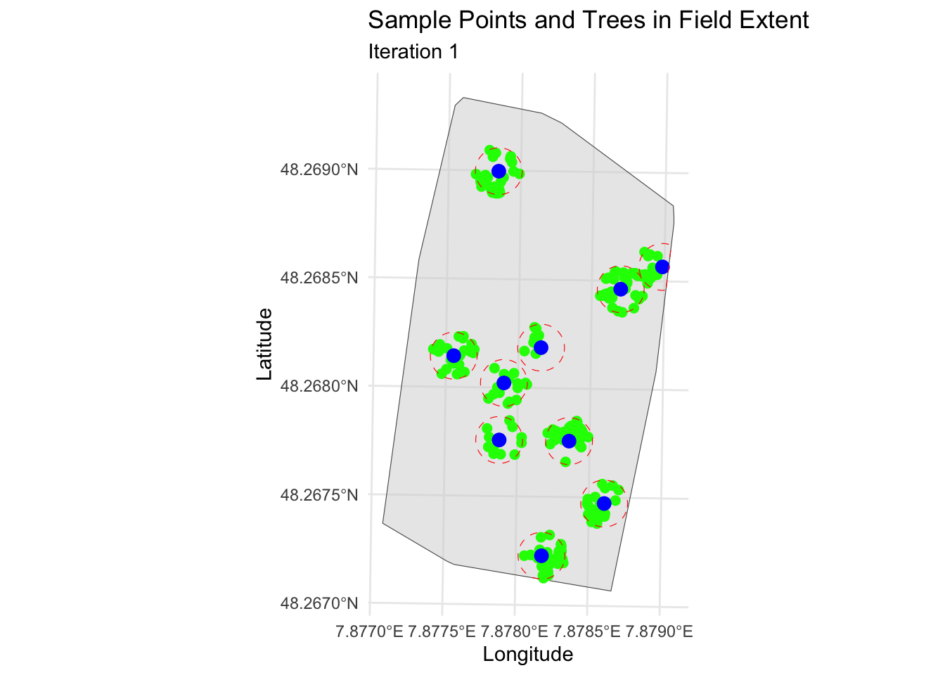
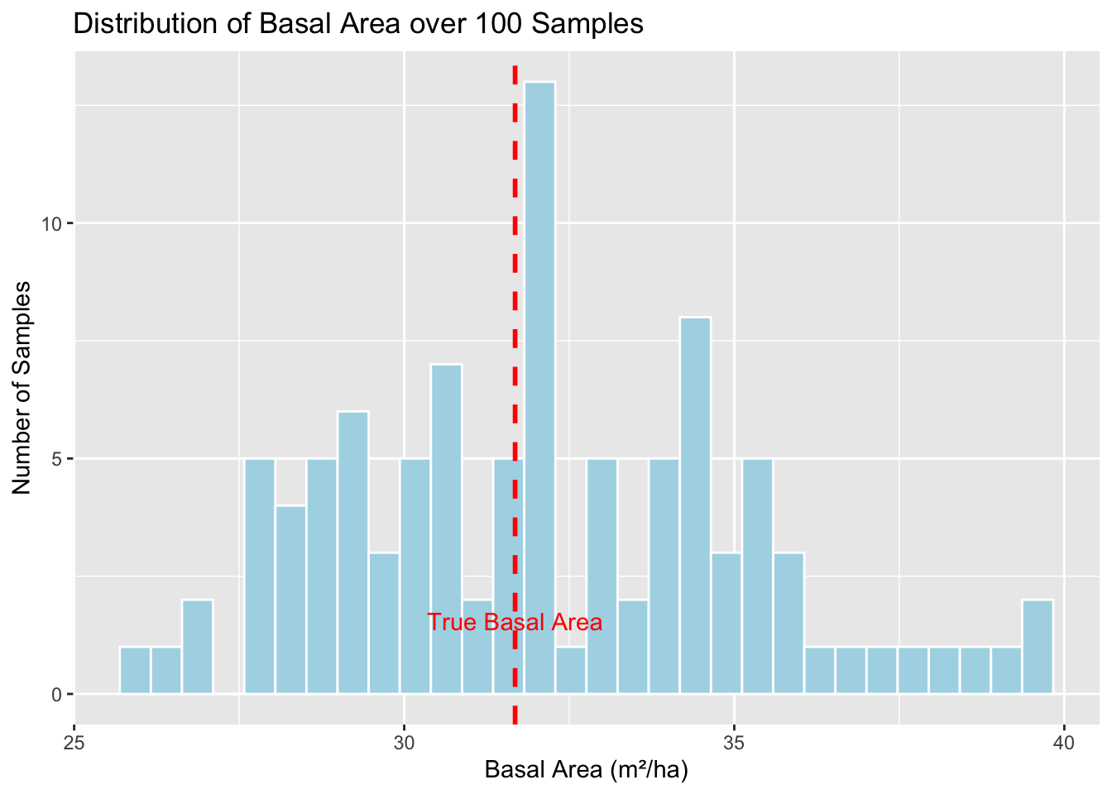
Viewing data in R Simulation of samples – Random sampling and regular grid
What do you notice? Is that good? Is that bad?
“that’s just how it is?”

Slide 54
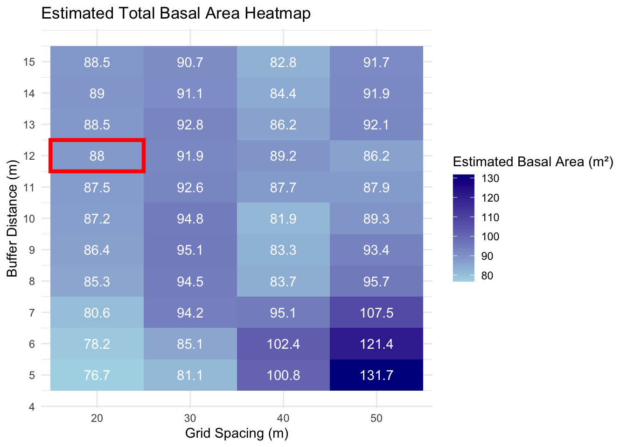
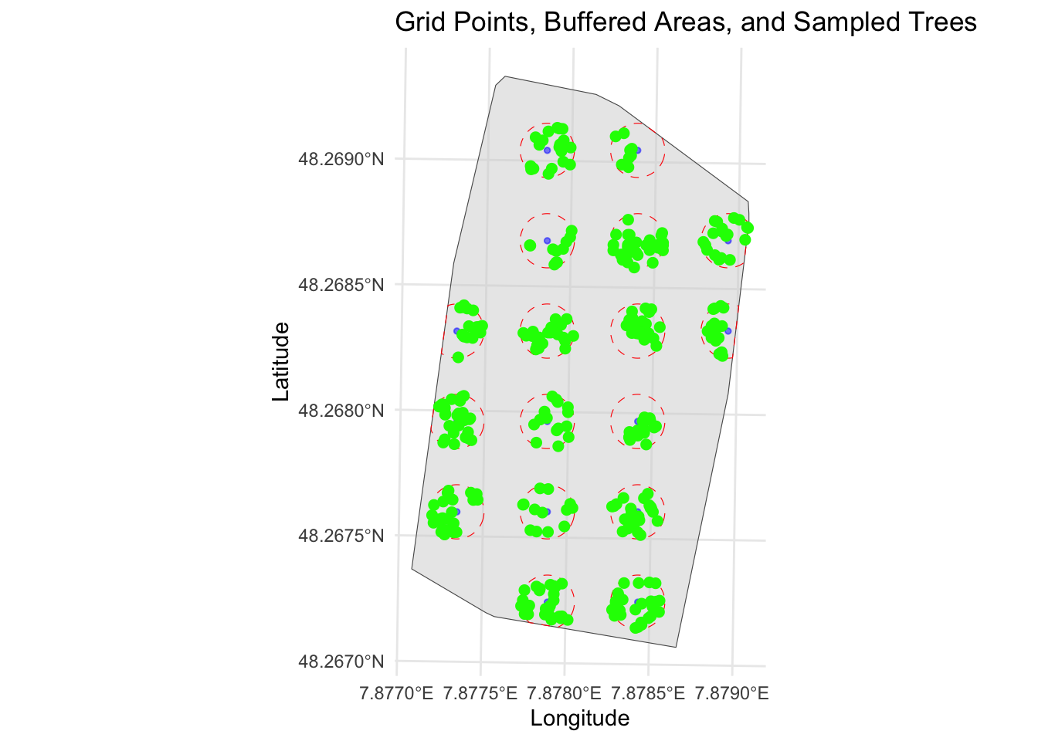
Viewing data in R Simulation of samples – Random sampling and regular grid
A regular grid is a simple and good method of getting a realistic image. Don't stick to one value (here, for example, 20/12) - this varies depending on the area and size!
There are also some extremes. It also requires a lot of work!

Slide 55
Viewing data in R “Real World Scenario“
"Imagine you go into the forest to set points whose exact coordinates have already been determined. You navigate to the locations using your smartphone or a GNSS device. But in the forest the signal jumps and you are never quite sure whether you are standing at the exact point. Nevertheless, you start measuring because "position is position", right? Later in the office you notice that the points are slightly shifted, some by as much as 2 m. This may mean that you have missed some trees that were measured in previous years. "
We simulate!
(In reality, such measuring points are precisely staked out so that the exact plot coordinates can be found again. Nevertheless, we want to know whether this is actually that serious)

Slide 56
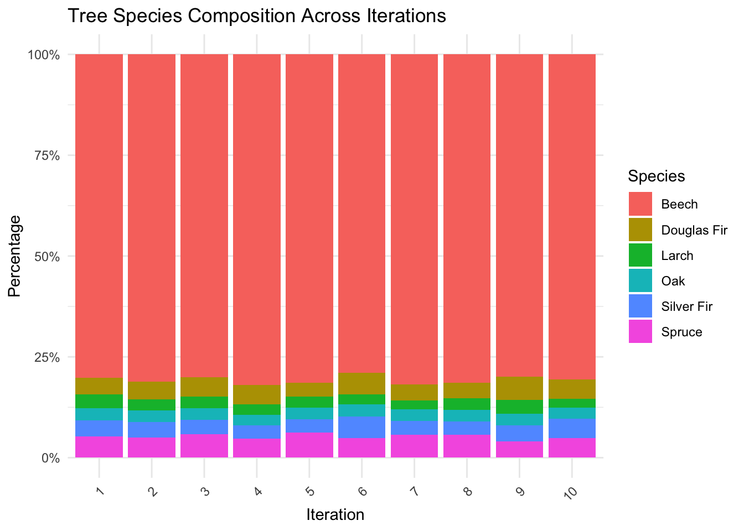
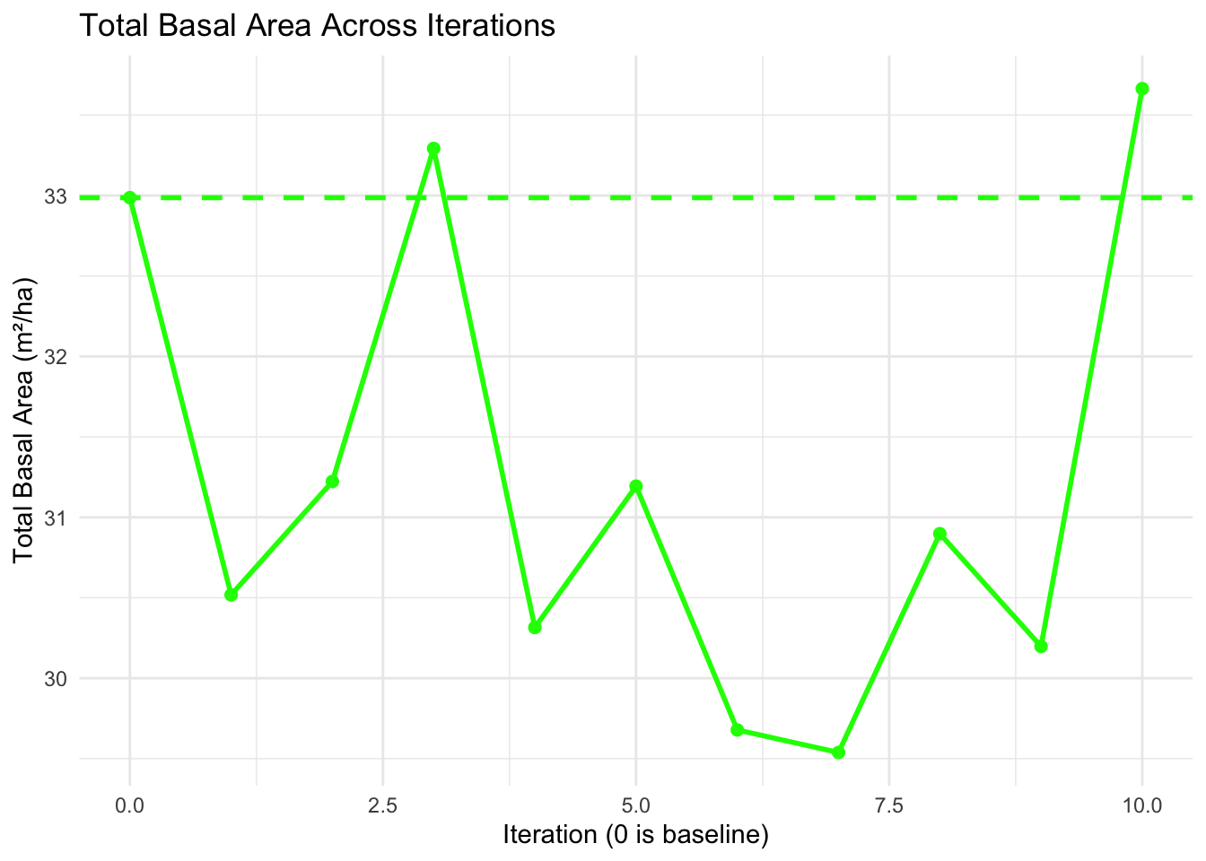
Viewing data in R Simulation of samples – GNSS uncertainties
→ Even a 2 m deviation from the actual plot has immense effects on the result

Slide 57
TAKE HOME – and what questions do you still have?
We now know
... what the Ecosense forest looks like (at least on paper)
... what sampling uncertainty is
... why this is important for forest inventories
... that there are random and systematic errors
... how we can quantify these errors
... how we can address the uncertainties
... how we can simulate forest inventories
... how we can represent geodata in R
... how we can distribute plots sensibly
... what the effects of (position-)inaccurate measurements are

